Slide 1
MACHINE LEARNING · FINTECH
PSX Stock Buy / Sell Signal
Prediction System
An end-to-end Machine Learning pipeline for the Pakistan Stock Exchange — from automated data scraping and technical feature engineering to risk-managed Buy / Sell signals and an interactive Streamlit dashboard.
Python
Selenium
scikit-learn
LightGBM
Streamlit
Plotly
pandas
PROJECT TEAM
TEAM LEAD
Muhammad Abdullah
Sheeraz
Rabia
Data scraping · RSI · ML models · Integration
Data cleaning & preparation
Streamlit dashboard · Visualization · UI
Notes:
Good morning. Our final-year project is the PSX Stock Buy/Sell Signal Prediction System — a complete machine-learning pipeline for the Pakistan Stock Exchange. It scrapes five years of historical price data, engineers technical indicators, trains two models (Random Forest and LightGBM) to predict short-term up-moves, converts those probabilities into Buy/Sell signals under strict risk rules, and presents everything in an interactive Streamlit dashboard. The team is Muhammad Abdullah (team lead — scraping, RSI, both ML models and integration), Sheeraz (data cleaning and preparation), and Rabia (the Streamlit dashboard, visualization and UI). The whole stack is Python: Selenium, scikit-learn, LightGBM, Streamlit and Plotly.

Slide 2
01
PROBLEM STATEMENT
Why a data-driven signal engine for PSX?
THE PROBLEM
Challenges we had to solve
Most retail investors at the Pakistan Stock Exchange trade on tips, emotion and guesswork — with no systematic, repeatable way to decide when to buy or sell a stock.
No clean data feed
Market noise & overfit
BUSINESS VALUE
Objective BUY / STRONG BUY / HOLD calls per stock, per day
Every signal validated by a risk-managed backtest
Transparent reasoning: ML probability + technical confirmations
Automated scraping with pagination & strict de-duplication
Out-of-sample testing on the most recent 12 months only
WHY PSX MATTERS
Hundreds of actively traded tickers and high volatility
Far fewer free, data-driven tools than developed markets
No clean public price API — data must be scraped
Class imbalance
Downside risk
Balanced class weights so rare up-moves aren't ignored
ATR trailing stops + a hard 8–10% loss cap on every trade
PSX Buy / Sell Signal Prediction System
2
Notes:
The core problem: retail investors on the Pakistan Stock Exchange mostly act on tips and emotion, with no repeatable, data-backed method for timing entries and exits. The business value of our system is three-fold — it produces objective Buy/Sell/Hold calls for every stock each day, every signal is validated through a risk-managed backtest, and each call is explainable (an ML probability plus technical confirmations). PSX matters because it has hundreds of liquid tickers and is highly volatile, yet has far fewer free analytical tools than developed markets and offers no clean public API. The four engineering challenges we solved are shown on the right: getting clean data, controlling overfitting via out-of-sample testing, handling class imbalance with balanced weights, and capping downside risk with ATR stops and a hard loss cap.

Slide 3
02
DATA SOURCE & STATISTICS
Five years of PSX market history
749,460
3,768
463,378
13
Raw daily records scraped
Unique PSX tickers
Clean rows after filtering
Features per record
Feature reference
Source & acquisition
Field | Description
SYMBOL · Date | Stock ticker and trading date
OPEN · HIGH · LOW · CLOSE | Daily price OHLC values
VOLUME | Shares traded that day
LDCP | Last day closing price
CHANGE · CHANGE (%) | Day-over-day price move
RSI_1D · RSI_7D · RSI_30D | Relative Strength Index (engineered)
Source — PSX Data Portal (dps.psx.com.pk/historical), the official exchange archive
Method — automated Selenium + BeautifulSoup scraper over ~5 years of business days
Each trading day is paginated, parsed and de-duplicated by SYMBOL, then saved to CSV
Coverage: 2021-03-15 → 2026-03-13 (≈ 5 years, business days only)
Engineered RSI columns are added on top of the 10 raw market fields → 13 columns total.
PSX Buy / Sell Signal Prediction System
3
Notes:
Our data comes from the official PSX Data Portal at dps.psx.com.pk/historical. We wrote an automated scraper using Selenium to drive the page and BeautifulSoup with pandas to parse each day's table. It iterates over every business day across roughly five years, paginates through each day's results, and de-duplicates by stock symbol before saving. In total we scraped 749,460 raw daily records covering 3,768 unique tickers. After removing derivative/futures symbols containing a hyphen, 463,378 clean rows remain. Each record carries 13 columns — the raw market fields (OHLC, volume, LDCP, change) plus three engineered RSI columns at 1, 7 and 30-day horizons. The bar chart shows how many rows survive each pipeline stage; cleaning removes about 38% of rows, and the RSI step preserves the row count while adding indicator columns. Coverage runs from March 2021 to March 2026.

Slide 4
03
PROJECT SCOPE
What the system does — and what it doesn't
✓
In Scope
✕
Out of Scope
Automated PSX historical data scraping
Data cleaning & de-duplication
RSI + technical feature engineering
ML prediction: Random Forest & LightGBM
BUY / STRONG BUY / HOLD signal generation
Risk-managed portfolio backtesting
Interactive Streamlit dashboard & paper simulator
Live / automated trade execution
Portfolio management & financial advisory
International stock exchanges (PSX only)
Deep-learning models (LSTM / Transformers)
Real-time / intraday streaming data
Fundamental & news-sentiment analysis
Brokerage integration & real money
PSX Buy / Sell Signal Prediction System
4
Notes:
Scoping kept the project focused and achievable. In scope: the full offline pipeline — scraping, cleaning, RSI and technical feature engineering, two machine-learning models (Random Forest and LightGBM), generation of Buy / Strong Buy / Hold signals, a risk-managed backtest, and the Streamlit dashboard with a paper-trading simulator. Deliberately out of scope: anything touching real money or live markets — automated trade execution, portfolio advisory, brokerage integration, international exchanges, real-time intraday data, deep-learning models, and fundamental or news-sentiment analysis. This is an educational research and simulation system, not a trading product.

Slide 5
04
PROPOSED METHODOLOGY
The end-to-end workflow
1
PSX Data Source
dps.psx.com.pk/historical
Why these two models?
2
▼
Random Forest — a robust bagged-tree baseline that captures non-linear feature interactions, resists overfitting, stays interpretable, and uses balanced class weights.
LightGBM — a gradient-boosting model with a higher accuracy ceiling: leaf-wise growth, L1/L2 regularization and subsampling, and fast training on large datasets.
Data Scraping
Selenium + BeautifulSoup
3
▼
Data Cleaning
De-dup · hyphen filter
4
▼
Feature Engineering & RSI
RSI · MACD · ATR · BBands
5
▼
Random Forest Model
100 trees · depth 6
Data flow, end to end
6
▼
Raw daily prices → cleaned & de-duplicated → technical features (RSI, MACD, ATR, Bollinger, EMAs) → time-based split (≈4 yrs train / 1 yr out-of-sample) → probability of a 5–10 day up-move → quant confirmation filters → BUY / SELL signals → risk-managed backtest → interactive dashboard.
LightGBM Model
300 boosts · lr 0.05
7
▼
Buy / Sell Prediction
BUY · STRONG BUY · HOLD
8
▼
Streamlit Dashboard
7 pages · paper simulator
PSX Buy / Sell Signal Prediction System
5
Notes:
The methodology follows the pipeline on the left, top to bottom. We start at the PSX data source, scrape it with Selenium and BeautifulSoup, clean and de-duplicate it, then engineer technical features including multi-period RSI, MACD, ATR and Bollinger Bands. The same feature set feeds two models — Random Forest and LightGBM. Each predicts the probability of a short-term up-move, which is turned into Buy/Sell signals and finally surfaced in the Streamlit dashboard. On the right we explain model choice: Random Forest is our robust, interpretable baseline using bagged trees with balanced class weights; LightGBM is a gradient-boosting model with a higher accuracy ceiling thanks to leaf-wise growth, L1/L2 regularization and subsampling. The bottom panel summarizes the data flow in one line — from raw prices, through cleaning and feature engineering, a time-based train/test split, probability scoring, quant filters, signal generation, backtesting, and finally the dashboard.

Slide 6
05
RESPONSIBILITIES
Team roles & module ownership
Team Member | Role | Modules / Files | Key Responsibilities
Muhammad Abdullah | Team Lead | psx_scraper.py rsi_calculator.py random_forest.py light_gbm.py | PSX data scraping, RSI calculation, Random Forest & LightGBM models, project integration
Sheeraz | Data Engineer | clean_existing_data.py | Data cleaning & data preparation — de-duplication, hyphen-symbol removal, type normalization
Rabia | Dashboard Developer | app.py run_pipeline.py | Streamlit dashboard, Plotly visualization, paper simulator & UI development
Integrated by run_pipeline.py — one command runs all four steps: clean → RSI → Random Forest → LightGBM.
PSX Buy / Sell Signal Prediction System
6
Notes:
Work was divided cleanly by module. Muhammad Abdullah, the team lead, owned the data scraper, the RSI calculator, both machine-learning models — Random Forest and LightGBM — and the overall integration. Sheeraz owned data cleaning and preparation, implemented in clean_existing_data.py: de-duplication, removing hyphenated derivative symbols, and normalizing data types. Rabia built the Streamlit dashboard and the orchestration entry point — app.py and run_pipeline.py — covering all visualization, the paper-trading simulator and the UI. The whole pipeline is wired together by run_pipeline.py, which runs the four stages in sequence with a single command.

Slide 7
06
SYSTEM ARCHITECTURE
End-to-end pipeline architecture
Orchestrated by run_pipeline.py · Steps 1 → 4 run with one command
Data Acquisition
psx_scraper.py · Selenium + BeautifulSoup → dps.psx.com.pk/historical
1
▼
Data Processing
clean_existing_data.py · rsi_calculator.py · technical feature engineering
2
▼
Machine Learning
random_forest.py · light_gbm.py — train · out-of-sample test · signals · backtest
3
▼
Output Artifacts
*_signals.csv · *_trade_log.csv · *_portfolio_history.csv · *_position_sensitivity.csv
4
▼
Presentation
app.py · Streamlit dashboard (7 pages) · Plotly charts · paper simulator
5
PSX Buy / Sell Signal Prediction System
7
Notes:
The architecture is a clean five-layer pipeline, orchestrated end-to-end by run_pipeline.py in four steps. Layer one is data acquisition — the Selenium and BeautifulSoup scraper pulling from the PSX portal. Layer two is processing — cleaning in clean_existing_data.py and indicator computation in rsi_calculator.py, plus the technical feature engineering done inside the model scripts. Layer three is machine learning — random_forest.py and light_gbm.py, each of which trains the model, tests out-of-sample, generates signals and runs the backtest. Layer four is the output artifacts — the signal, trade-log, portfolio-history and position-sensitivity CSVs for both models. Layer five is presentation — app.py, the Streamlit dashboard with seven pages, Plotly charts and the paper simulator, which simply reads those CSVs. The layers are decoupled through CSV files, so each can be developed and tested independently.

Slide 8
07
MODELING APPROACH
Features, targets & model configuration
8 SHARED MODEL FEATURES
Model configuration
RSI_7D
RSI_30D
Parameter | Random Forest | LightGBM
Algorithm | Bagged trees | Gradient boosting
Estimators | 100 | 300
Max depth | 6 | 6
Learning rate | — | 0.05
Num leaves | — | 31
Regularization | class_weight= balanced | L1 0.1 · L2 0.1 subsample 0.8
Target horizon | 5 days / +1.5% | 10 days / +3%
Random state | 42 | 42
Vol_Ratio
MACD_Hist
ATR_Pct
Dist_EMA20
Dist_SMA200
BB_Width
Derived from RSI, MACD, ATR, Bollinger Bands, EMA-20/50, SMA-200 and volume.
PREDICTION TARGETS
Random Forest — price up > 1.5% within 5 days (Target_5D)
LightGBM — price up > 3% within 10 days (Target_10D)
VALIDATION
Time-based split — train on the first ≈4 years, test on the most recent 12 months (out-of-sample). Scored by ROC-AUC; balanced class weights handle imbalance.
PSX Buy / Sell Signal Prediction System
8
Notes:
Both models share the same eight engineered features, shown on the left — two RSI horizons, a volume ratio, the MACD histogram, ATR as a percentage of price, distance from the 20-day EMA and 200-day SMA, and Bollinger Band width. These are computed from standard indicators: RSI, MACD, ATR, Bollinger Bands and moving averages. The prediction targets differ slightly by model: Random Forest predicts whether price rises more than 1.5% within five days; LightGBM uses a longer, stronger move — over 3% within ten days — to match swing-trade execution. We validate with a strict time-based split: train on the earliest four years, test only on the most recent twelve months, so there is no look-ahead. We score with ROC-AUC and use balanced class weights because up-moves are the minority class. The table on the right gives the exact configuration: Random Forest is 100 trees at depth 6; LightGBM is 300 boosting rounds at learning rate 0.05 with leaf-wise growth and L1/L2 regularization. Both use a fixed random seed for reproducibility.

Slide 9
08
SIGNALS & RISK MANAGEMENT
From probability to a risk-managed trade
Signal decision framework
Risk-managed backtest engine
ML probability gate
RF ≥ 0.55 / 0.65 · LightGBM dynamic 90–95th percentile (floors 0.45 / 0.50)
+ Quant confirmations (≥2 → BUY, ≥3 → STRONG BUY)
trend (Close > EMA-50) · MACD_Hist > 0 · Volume ratio ≥ 1.2
+ Regime filter
minimum liquidity (Vol_MA20) and volatility (ATR%)
– Overbought reject
skip if RSI_7D > 75 / 80 → otherwise HOLD
Rs. 100,000 start · max 2 concurrent positions (sweepable 2–10)
ATR trailing stops (2–2.5× ATR) + hard loss cap: 10% RF / 8% LGBM
Reward targets (3–4× ATR), break-even lock-in, time stop (15–30 days)
Risk-based position sizing (LGBM: 2% risk, 12% max position)
Trade log, equity curve & position-sensitivity sweep exported to CSV
ML probability
▶
Quant confirmations
▶
Regime filter
▶
BUY / STRONG BUY
▶
Position sizing
▶
Stops & targets
PSX Buy / Sell Signal Prediction System
9
Notes:
A model probability alone is not a trade — it has to pass several filters. The decision framework, on the left, works as a funnel. First, a probability gate: Random Forest needs at least 0.55 (0.65 for a strong buy); LightGBM uses dynamic 90th-95th percentile thresholds with floors. Then quant confirmations must agree — an uptrend with close above the 50-day EMA, a positive MACD histogram, and above-average volume; two confirmations give a BUY, three give a STRONG BUY. A regime filter requires minimum liquidity and volatility, and we reject overbought names where RSI is very high. Everything else is HOLD. On the right is the backtest engine that turns signals into trades: Rs. 100,000 of starting capital, a small number of concurrent positions, ATR-based trailing stops with a hard 8-10% loss cap, reward targets, break-even lock-in, a time stop, and risk-based position sizing. Every trade, the equity curve and a position-count sensitivity sweep are exported to CSV. The strip at the bottom shows that funnel end to end.

Slide 10
09
BACKTEST RESULTS
Out-of-sample performance (last 12 months)
+139.3%
Rs. 239,322
+14.8%
90
Random Forest portfolio ROI
RF final equity (from Rs. 100k)
LightGBM portfolio ROI
Trades executed (RF 39 · LGBM 51)
Random Forest vs LightGBM
Metric | Random Forest | LightGBM
Final equity | Rs. 239,322 | Rs. 114,829
Net profit | Rs. 139,322 | Rs. 14,829
Portfolio ROI | +139.3% | +14.8%
Trades | 39 | 51
Win rate | 46.2% | 43.1%
Avg trade ROI | +5.3% | +1.9%
Best / worst trade | +48.2% / -18.2% | +46.4% / -10.0%
Sensitivity: RF peaks near +144% ROI at 3 positions; LightGBM keeps improving with more slots (up to ≈ +83% at 9).
Note: Backtested, out-of-sample (Mar 2025 – Mar 2026), max 2 positions. Educational simulation — not financial advice.
PSX Buy / Sell Signal Prediction System
10
Notes:
These are out-of-sample results — the models never saw this last year during training. On the same Rs. 100,000 starting capital and a maximum of two concurrent positions, Random Forest turned 100,000 into about 239,000, a 139% portfolio ROI across 39 trades, with a 46% win rate and an average trade of plus 5.3%. LightGBM was more conservative — about 15% ROI over 51 trades at a 43% win rate. Both have similar best trades near plus 47%, but Random Forest's risk rules let winners run further. Two honest caveats: first, the position-sensitivity sweep shows results depend on how many positions you allow — Random Forest peaks around 144% at three positions, while LightGBM improves steadily as you add slots. Second, and most importantly, this is a historical backtest and an educational simulation, not financial advice; real trading would face costs, slippage and changing market regimes.

Slide 11
10
INTERACTIVE DASHBOARD
Streamlit model-comparison dashboard
How it loads
Seven pages
Model output CSVs
1
Dashboard
KPI cards + equity curve + scoreboard
RF + LightGBM signals, trades, portfolio, sensitivity
2
Model Comparison
RF vs LGBM metrics, side-by-side
▼
3
Position Sensitivity
ROI / win-rate vs max positions
load_model_outputs()
cached with @st.cache_data, path fallbacks
4
Recommendations
Filterable Buy calls + model overlap
▼
5
Simulator
2-stock paper trading (10% stop / 8% target)
Unified metrics & frames
ROI, win rate, profit factor per model
6
Trade History
Trade log + exit-reason distribution
▼
7
Search
Query signals & trades across history
7 navigable pages
Plotly charts + interactive tables
Built with
Streamlit
Plotly
pandas
NumPy
PSX Buy / Sell Signal Prediction System
11
Notes:
The dashboard is a Streamlit app and it never re-runs the models — it simply reads the CSV artifacts the pipeline produced. On the left is the load path: it finds the Random Forest and LightGBM output CSVs, loads them through a cached loader so the app stays fast, computes a unified set of metrics per model — ROI, win rate, profit factor — and exposes everything through seven pages. Those pages, on the right, are: a main Dashboard with KPI cards and the equity curve; a side-by-side Model Comparison; a Position Sensitivity explorer; a Recommendations page with model-overlap analysis; an interactive two-stock paper-trading Simulator with a 10% stop and 8% target rule; a Trade History page with exit-reason breakdowns; and a Search page across all historical signals and trades. It's built with Streamlit, Plotly, pandas and NumPy, with a custom dark glassmorphism theme.

Slide 12
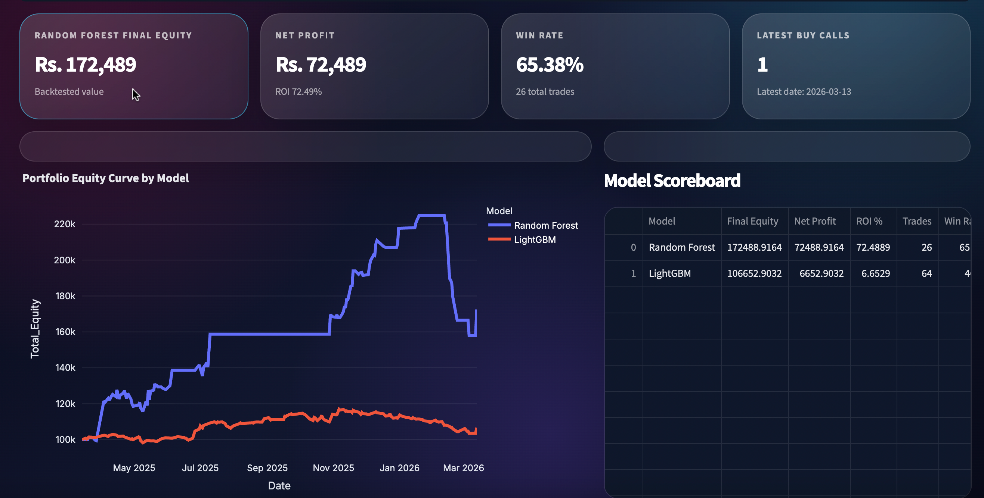
DASHBOARD PREVIEW
Notes:
This is a faithful mock-up of the actual running dashboard, recreated from the Streamlit code in app.py. On the left is the navigation sidebar with all seven pages and a loaded-models indicator. The main area opens with a hero banner, then four KPI cards — final equity, net profit, win rate and the latest buy calls — followed by the headline visual: the portfolio equity curve comparing both models. You can clearly see Random Forest, in cyan, climbing far above LightGBM in gold over the test year, peaking near 390,000 before settling around 239,000. To the right is the model scoreboard summarizing ROI and win rate. The real app uses a dark glassmorphism theme with Plotly charts, and every number here is pulled live from the generated CSV files. A footer reminds users it's an educational paper simulator capped at two stocks with rule-controlled sells.

Slide 13
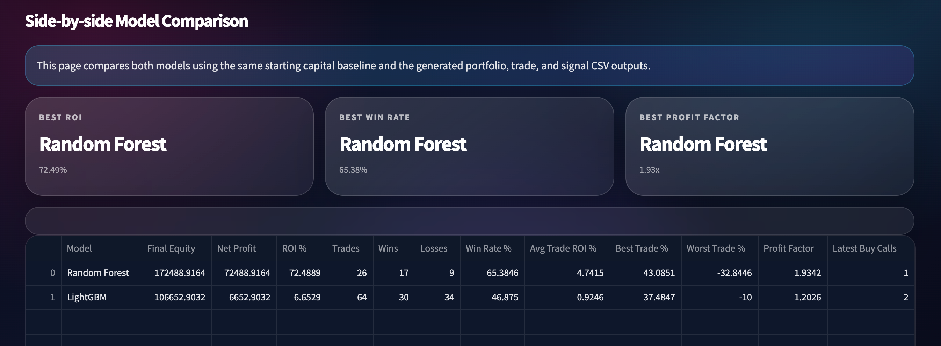
MODEL COMPARISON
Notes:
This is a faithful mock-up of the actual running dashboard, recreated from the Streamlit code in app.py. On the left is the navigation sidebar with all seven pages and a loaded-models indicator. The main area opens with a hero banner, then four KPI cards — final equity, net profit, win rate and the latest buy calls — followed by the headline visual: the portfolio equity curve comparing both models. You can clearly see Random Forest, in cyan, climbing far above LightGBM in gold over the test year, peaking near 390,000 before settling around 239,000. To the right is the model scoreboard summarizing ROI and win rate. The real app uses a dark glassmorphism theme with Plotly charts, and every number here is pulled live from the generated CSV files. A footer reminds users it's an educational paper simulator capped at two stocks with rule-controlled sells.

Slide 14
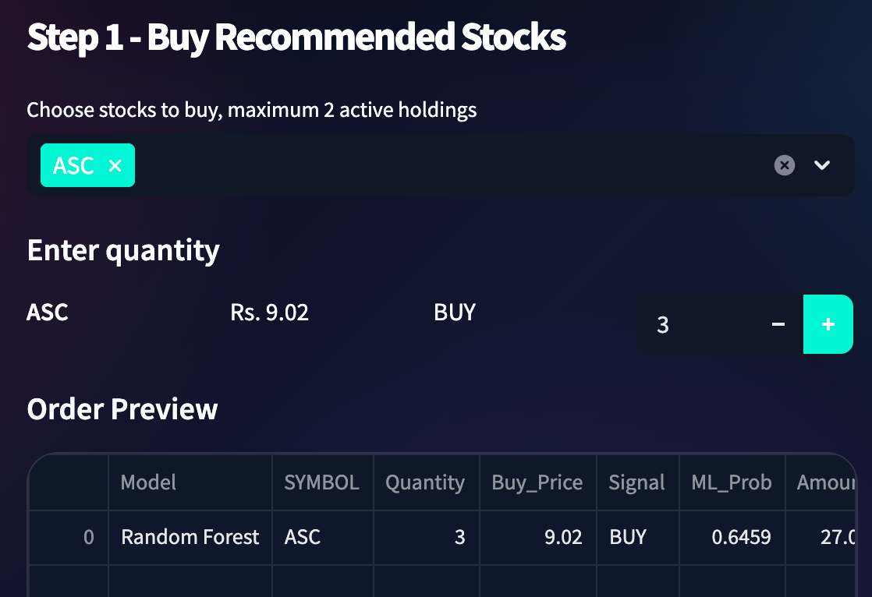
RECOMMENDED STOCKS BUY/SELL
Notes:
This is a faithful mock-up of the actual running dashboard, recreated from the Streamlit code in app.py. On the left is the navigation sidebar with all seven pages and a loaded-models indicator. The main area opens with a hero banner, then four KPI cards — final equity, net profit, win rate and the latest buy calls — followed by the headline visual: the portfolio equity curve comparing both models. You can clearly see Random Forest, in cyan, climbing far above LightGBM in gold over the test year, peaking near 390,000 before settling around 239,000. To the right is the model scoreboard summarizing ROI and win rate. The real app uses a dark glassmorphism theme with Plotly charts, and every number here is pulled live from the generated CSV files. A footer reminds users it's an educational paper simulator capped at two stocks with rule-controlled sells.

Slide 15
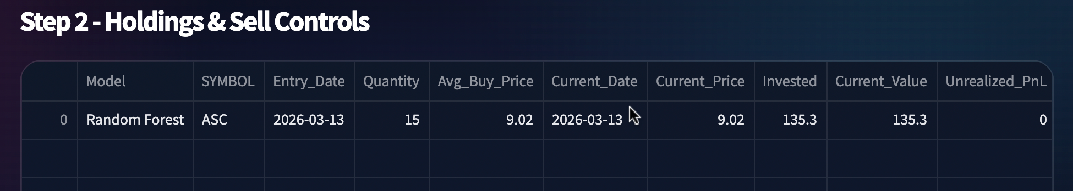
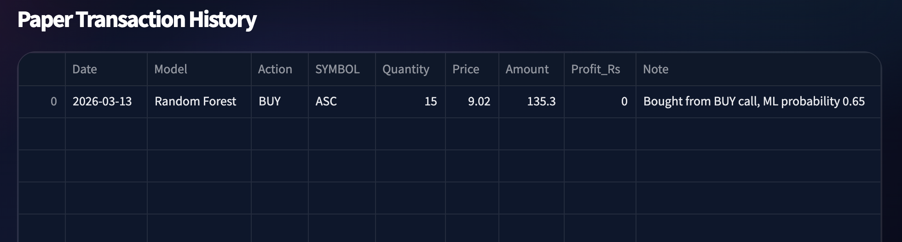
DECISION RECOMMENDERS
Notes:
This is a faithful mock-up of the actual running dashboard, recreated from the Streamlit code in app.py. On the left is the navigation sidebar with all seven pages and a loaded-models indicator. The main area opens with a hero banner, then four KPI cards — final equity, net profit, win rate and the latest buy calls — followed by the headline visual: the portfolio equity curve comparing both models. You can clearly see Random Forest, in cyan, climbing far above LightGBM in gold over the test year, peaking near 390,000 before settling around 239,000. To the right is the model scoreboard summarizing ROI and win rate. The real app uses a dark glassmorphism theme with Plotly charts, and every number here is pulled live from the generated CSV files. A footer reminds users it's an educational paper simulator capped at two stocks with rule-controlled sells.

Slide 16
CONCLUSION
What we built — and where it goes next
What we delivered
Limitations & next steps
A complete, automated PSX ML pipeline (one command end-to-end)
Two models — Random Forest & LightGBM — on a 5-year, 3,768-ticker dataset
Explainable BUY / SELL signals with strict, ATR-based risk controls
A risk-managed backtest with a full trade log and equity curve
An interactive 7-page Streamlit comparison dashboard & paper simulator
Add walk-forward validation & guard against look-ahead bias
Model transaction costs, slippage & liquidity limits
Explore deep-learning sequence models (LSTM / Transformers)
Live data feed with scheduled refresh & signal alerts
Add fundamental & news-sentiment features
Thank you
Questions?
Muhammad Abdullah (Lead) · Sheeraz · Rabia
Python
scikit-learn
LightGBM
Streamlit
Notes:
To conclude: we delivered a complete, automated machine-learning pipeline for the Pakistan Stock Exchange — from scraping five years of data across nearly 3,800 tickers, through feature engineering, two trained models, explainable risk-managed signals, a full backtest, and an interactive seven-page dashboard, all runnable with a single command. We're honest about limitations: the results are in-sample to one historical year and don't yet model trading costs. Our next steps are walk-forward validation, adding transaction costs and slippage, exploring deep-learning sequence models like LSTMs, wiring in a live data feed with alerts, and adding fundamental and news-sentiment features. Thank you — Abdullah, Sheeraz and Rabia — and we're happy to take your questions.

